Slide 1
TwHIN: Embedding the Twitter Heterogeneous Information Network for Personalized Recommendation
Leah Lu, Sr. Data Scientist
2024 – 02 - 06
KDD '22: Proceedings of the 28th ACM SIGKDD Conference on Knowledge Discovery and Data Mining, August 2022, Pages 2842–2850 https://doi.org/10.1145/3534678.3539080

Slide 2
Outline
Background
TwHIN Embeddings Development
Experiments and Results for Recommendation
Practical Considerations
Miscellaneous:
Twitter's Recommendation Algo Open Source
Twitter Architecture 2022
Q&A
References

Slide 3
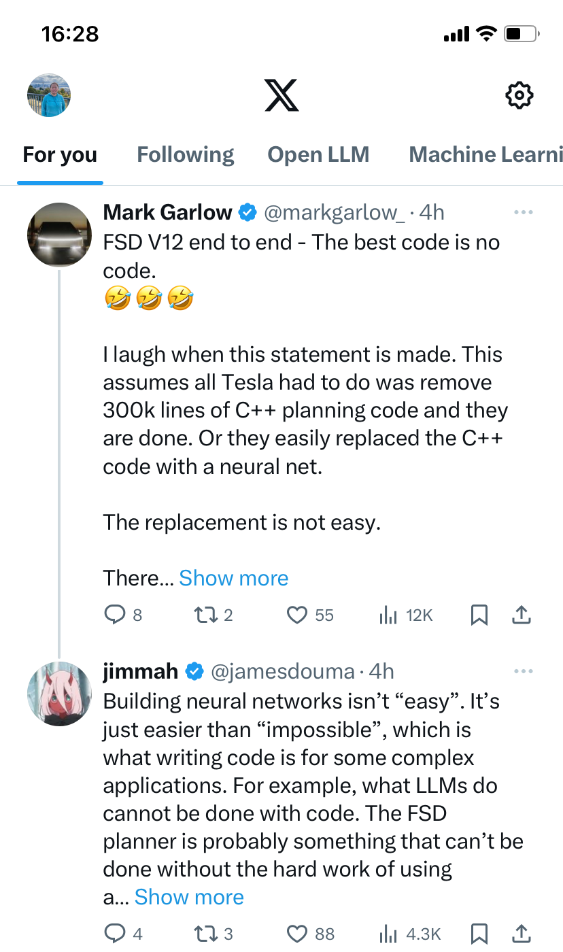
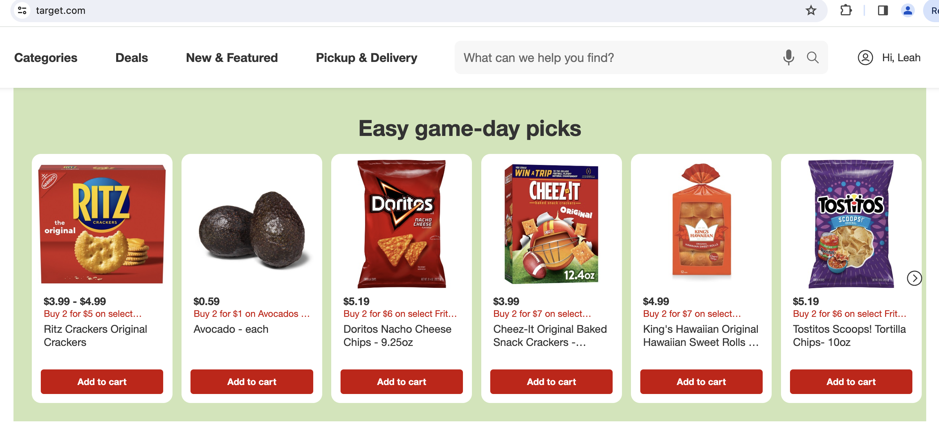
Personalized Recommendation
Target Recommendation items
‘For You’ at X, also called Twitter
Algorithms-driven to suggest a small number of interesting items out of millions for each user and critical to effectively explore user’ interest.
Notes:
to analyze a user's past behavior, preferences, and interactions to suggest tailored content, products, or services likely to be of interest to that specific user.

Slide 4

Embeddings
Embedding started with Word2Vec (2013, Google), credited the Test of Time Award at the NeurIPS Conference 2023.
e.g. king = [-0.74501 , -0.11992 , 0.37329 , 0.36847, ….];
queen = [-1.1266 , -0.52064 , 0.45565 , 0.21079 , ….]
Notes:
an embedding is essentially a high-tech, mathematical way of capturing and representing all those intricate ideas, relationships, and contexts of words, sentences, or even entire documents in a form that computers can understand.

Slide 5

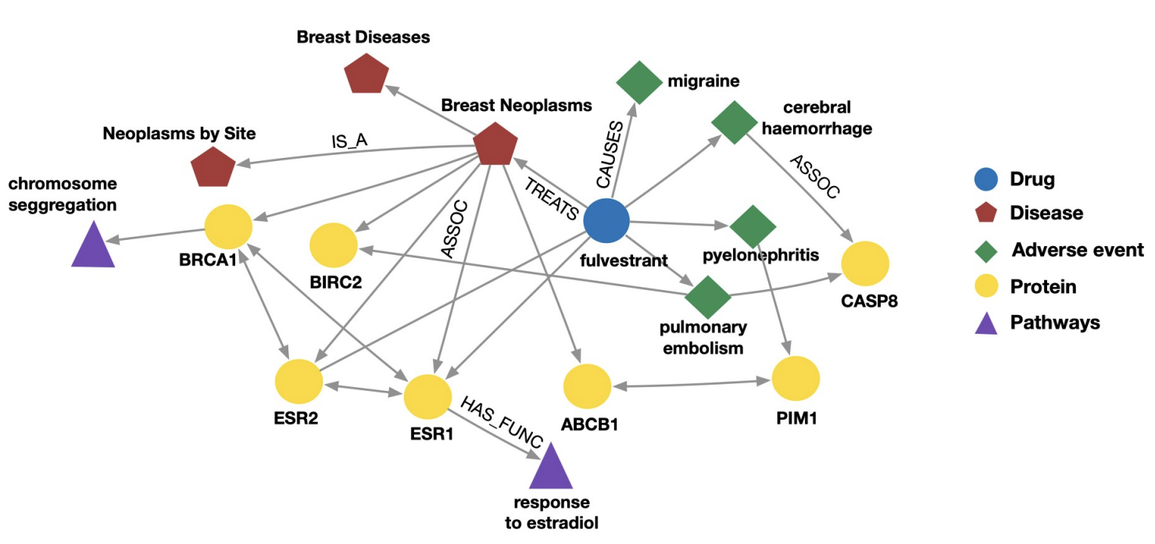
Graph: entities (nodes) with relations
Knowledge graph: nodes, edges, relationship representing real-world knowledge, G = {entity, relation, entity’}
Social graph (Credit: Medium)

Slide 6
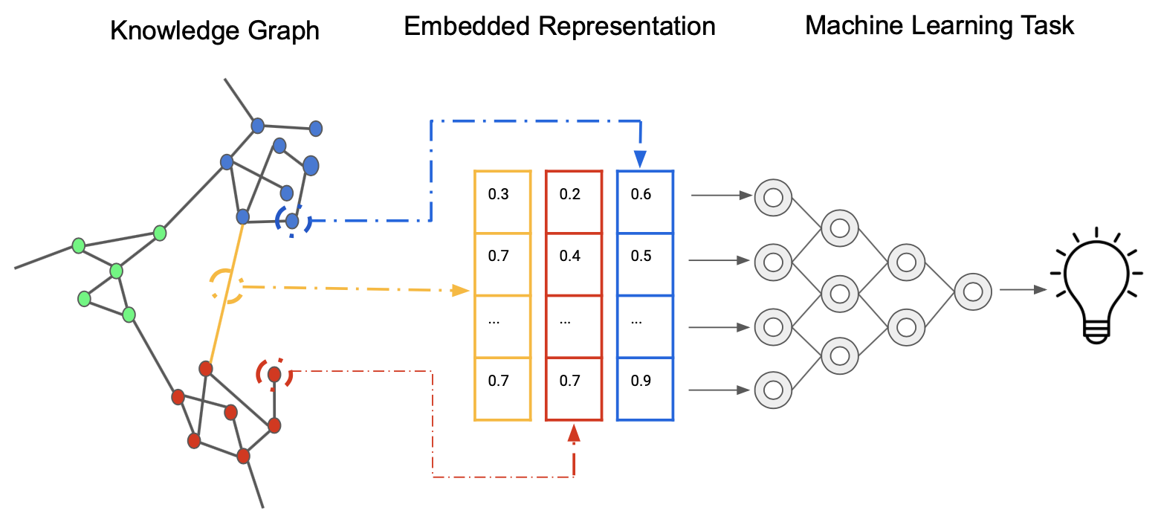
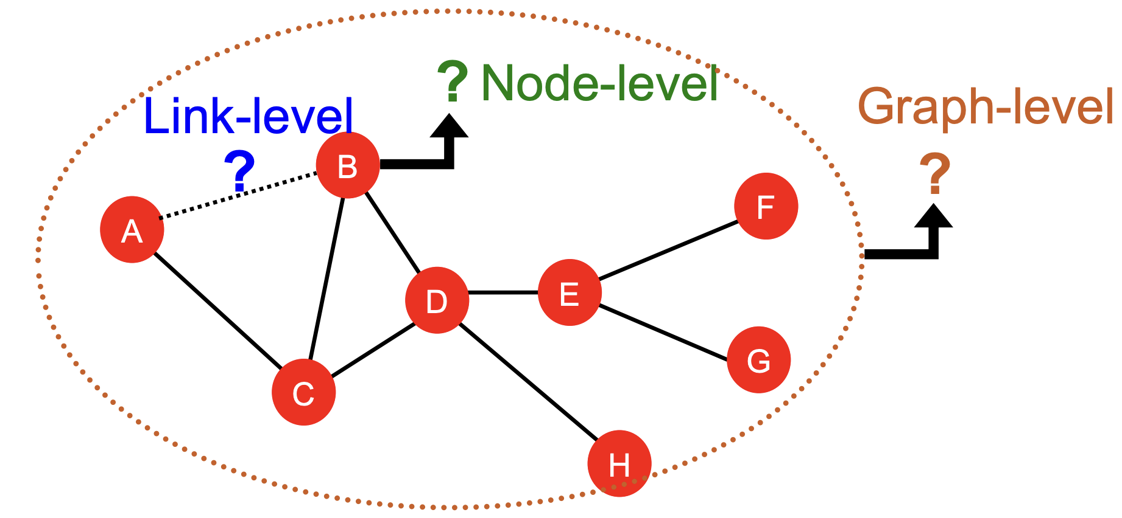
Knowledge Graph Embedding
Node-level prediction
Link-level prediction
Graph-level prediction
Learn graph's inherent structure and the semantics of its relationships and present nodes/edges as vectors

Slide 7
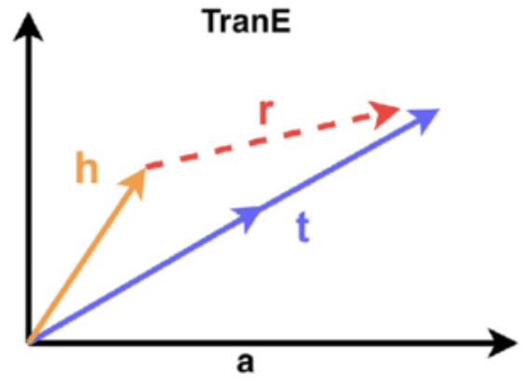
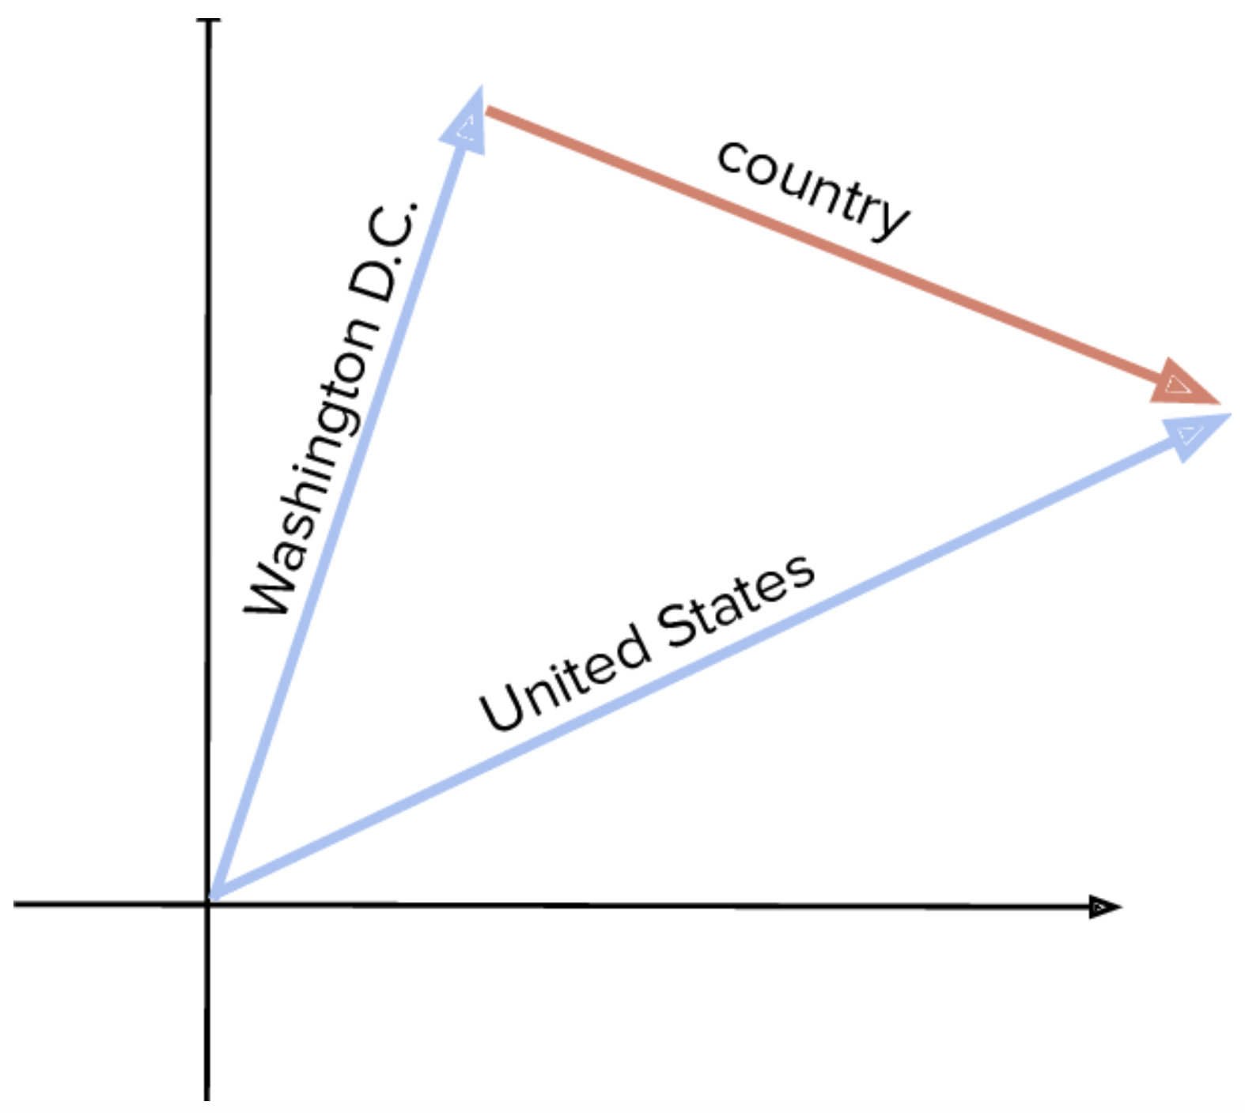
TransE (Translation Embeddings)
Illustration for TransE:
For {head, relation, tail} with embedding vectors
h+r≈t if a link exists
Entity scoring function: f(h, t) = ||h + r – t||
Loss Function: maximize difference between positive triples (true facts) and negative triples (false facts)
Negative Sampling: (h′,r,t) or (h,r,t′) vs (h,r,t) (Positive)
Notes:
The entity scoring function in a knowledge graph embedding model like TransE measures how well a proposed relationship between two entities fits the data observed during training. It produces a numerical score indicating the likelihood that a given head entity and tail entity are connected by a specific relation.
On the other hand, the loss function is used during the training of the model to measure the difference between the predicted scores and the actual labels (true relationships). The loss function guides the optimization process by quantifying how much the current model parameters need to be adjusted to minimize the error in the predictions.
In summary, while the scoring function provides a plausibility score for each entity-relation pair, the loss function aggregates these scores across many examples to direct the learning process.

Slide 8
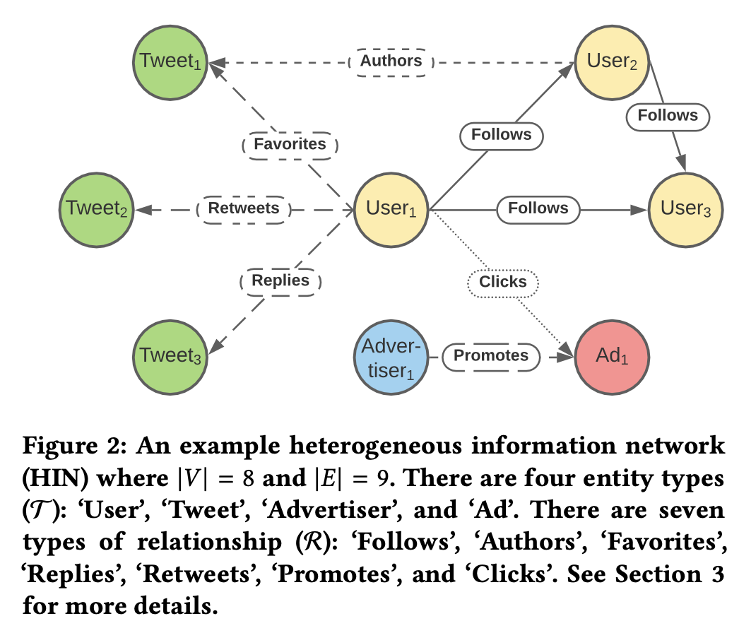
Twitter Heterogeneous Information Network
Characteristics:
multi-type and multi-relational data, encode valuable information about social network entities not fully captured by a single relation
4 Entities: User, Tweet, Advertiser, Ad
7 types of relationship
Innovations:
Data Supplementation
Task Reusability

Slide 9
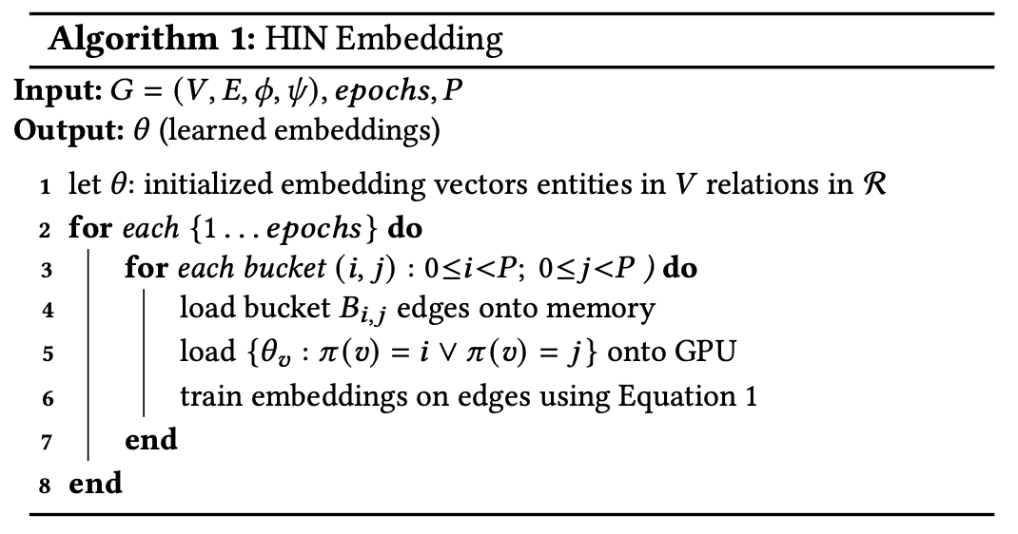
TwHIN Embedding Development
Input data: 10^9 nodes and 10^11 edges
Relationship: social signals (follow-graph), content engagement signals (Tweet, image, and video engagement), advertisement engagements
TransE and Loss function
Computational Implementation
TwHIN: deriving two high-coverage networks (1) follow-graph and (2) User-Tweet engagement graph.

Slide 10
Inductive multi-modal embeddings
Shortcomings in considerations
Single Embedding Limitation: Entities are limited to single embedding vector when "multi-modal interests.”
Transductive Learning Limitation: embeddings for entities are transductive from knowledge graph, but new entities (referred to as "out-of-vocabulary nodes") have no embeddings
Solutions for post-processing
Inductive Embedding of New or Cold-Start Nodes: infer embeddings for new nodes from the entities in the graph
Cluster Existing Unimodal Embeddings and Compute Multiple Embeddings for a Node: generate ‘multi-modal’ embeddings from the clusters

Slide 11
Evaluation on TwHIN embeddings
Advancement in methodologies
Cold-start for new nodes
Optimization in practice
Computational Consideration and Scaling

Slide 12
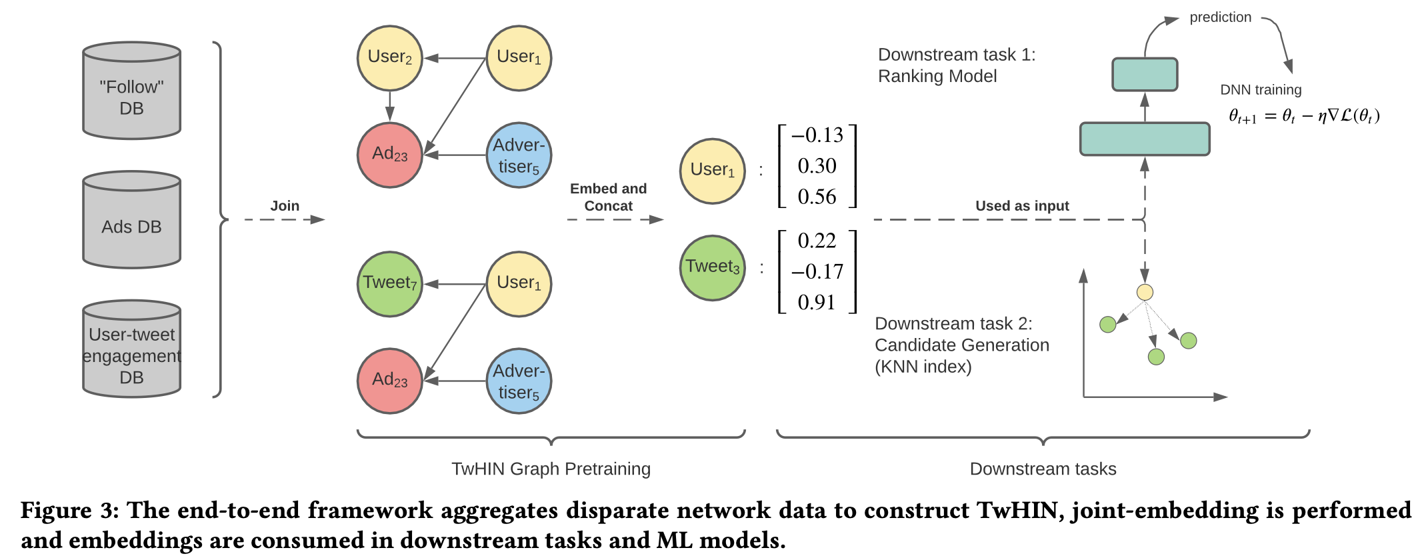
TwHIN Application for Recommendation

Slide 13
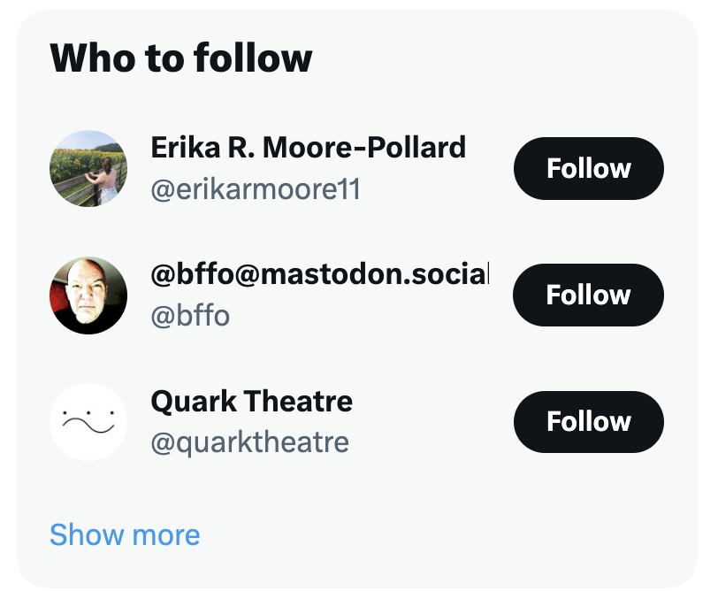
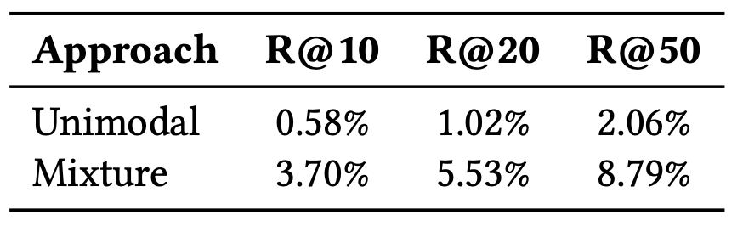
‘Who to Follow’ use case
Experiment groups
Unimodal (Control): basic feature + graph embedding
Mixture (Test): basic feature + TwHIN Embeddings
Models
Nearest Neighbor: retrieve Twitter accounts to follow
Evaluation Metrics:
Recall: ability of a model to find all the relevant cases within a data set

Slide 14

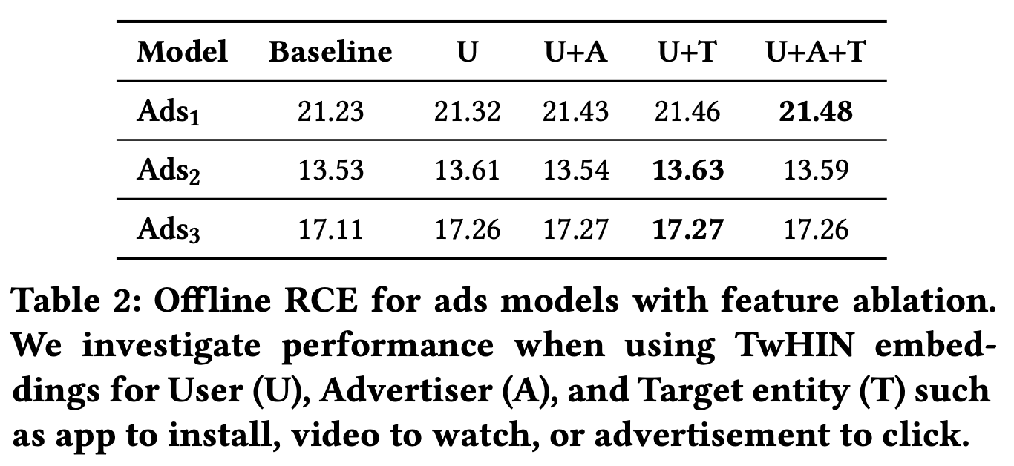
Ads Ranking
Experiment groups
Baseline / Control : Basic feature
TwHIN (Test):
Basic feature + U (User)
Basic feature + U+A (User + Advertiser)
Basic feature + U+T (User + Entity)
Basic feature + U+A+T (User + Advertiser + Entity)
Models
Supervised Classification
Evaluation Metrics:
Relative Cross Entropy (RCE), derived from probability, the higher the better

Slide 15

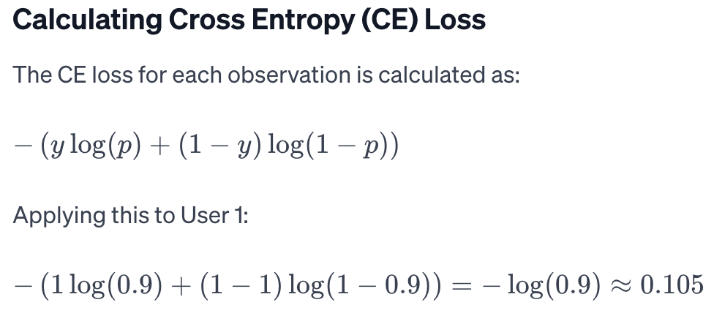
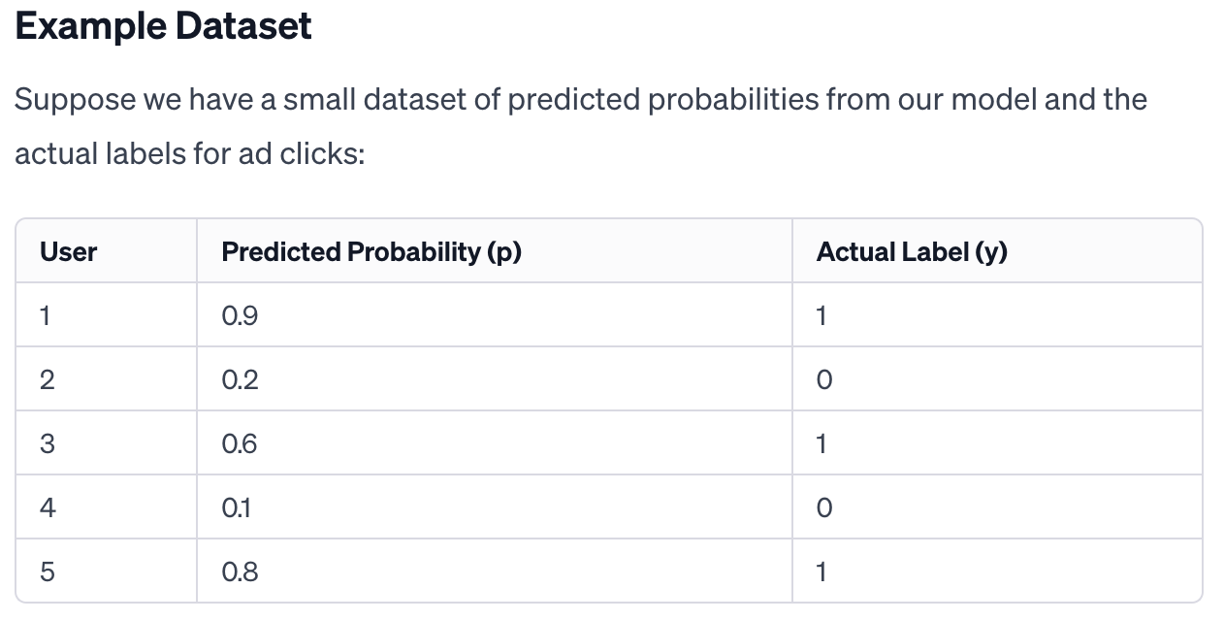
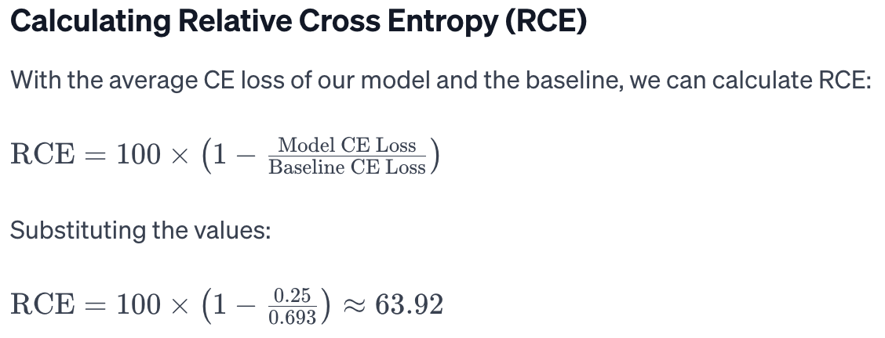
Relative Cross Entropy (RCE)

Slide 16
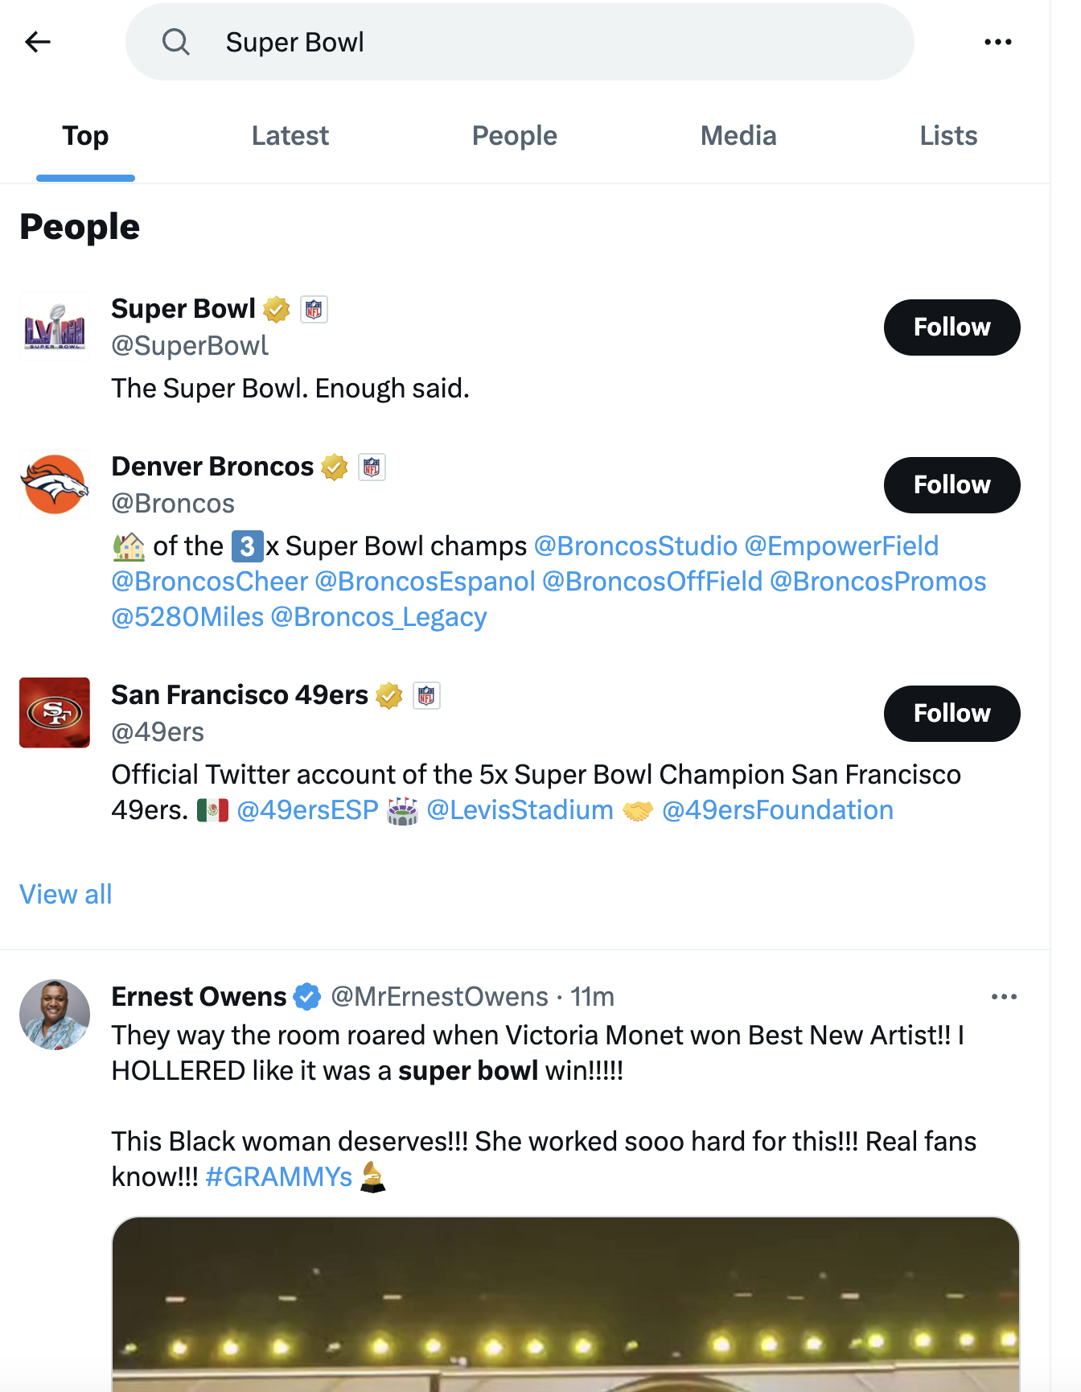
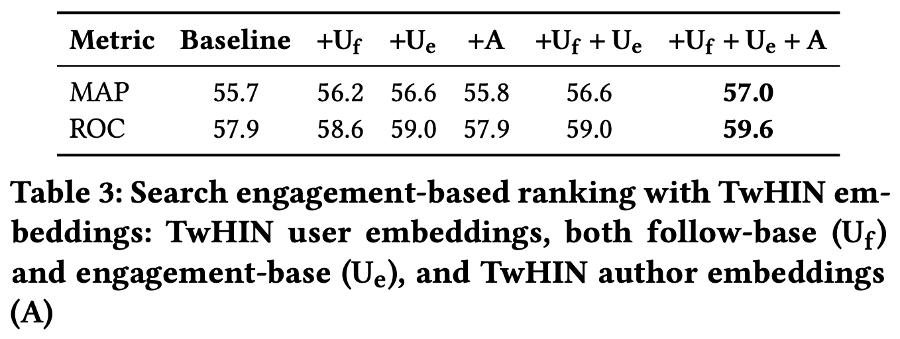
Search Ranking
Experiment groups
Baseline / Control: Hand-Crafted Features + mBERT Outputs
TwHIN (Test): Hand-Crafted Features + mBERT Outputs + TwHIN Embeddings
Models
Supervised classification -- MLP (Multilayer Perceptron) for engagement prediction
Evaluation Metrics:
MAP (Mean Average Precision)
ROC (Receiver Operating Characteristic)

Slide 17

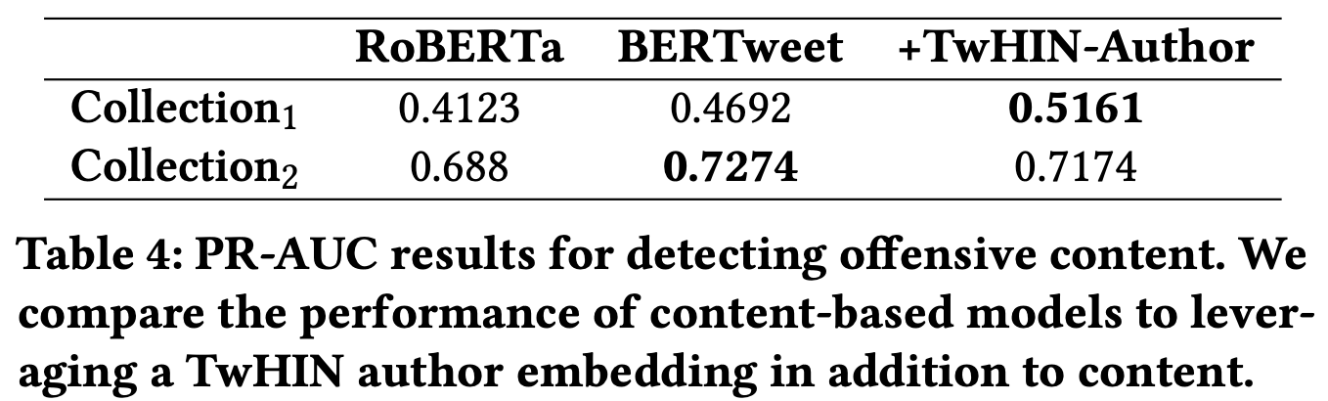
Detecting Offensive Content
Experiment groups
Baseline / Control : RoBERTa and BERTweet, most ‘state of the art’ approaches for contextual understanding
Test: Content + TwHIN-Author embeddings
Models
Supervised classification -- (e.g., neural network, logistic regression)
Evaluation Metrics:
AUC (Area Under the ROC Curve)

Slide 18
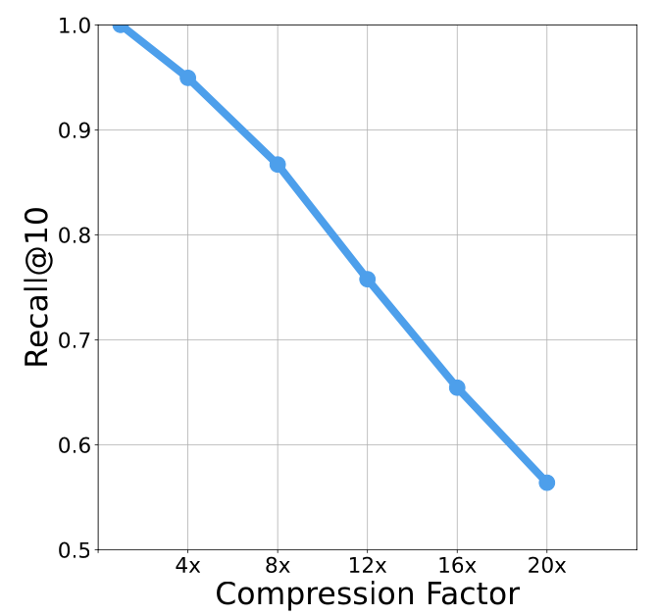
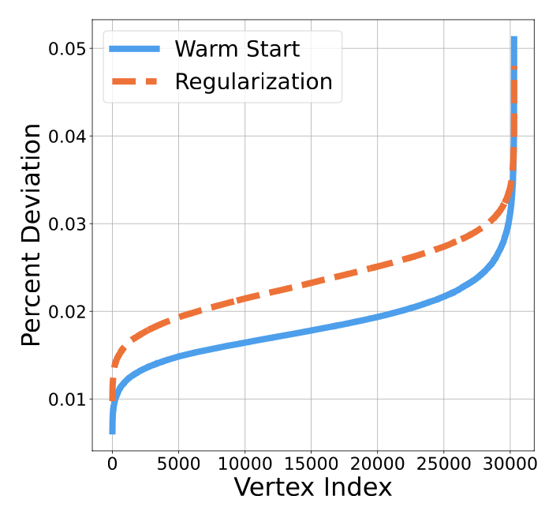
Practical Consideration
Compression for low latency
Quantization of vectors for downstream use cases
Addressing parameter drift across versions
Continue training as warm start
Apply regularization

Slide 19
Summaries
TwHIN: embeddings of a multi-type, multi-relation network, capturing the complexity of relationships, addressing data sparsity and improving the model's ability to generalize.
Experimental Validation: improvements with TwHIN embeddings for recommendation use cases
Implementation Insights: Practical tips and methodologies for effectively implementing, deploying, and leveraging large-scale heterogeneous graph embeddings
Notes:
TwHIN: TwHIN is Twitter's internal system for creating joint embeddings of a multi-type, multi-relation network, capturing the complexity of relationships within Twitter's data.
Superior Paradigm: Using joint embeddings of heterogeneous nodes and relations is considered superior to single-relation embeddings, addressing data sparsity and improving the model's ability to generalize across various tasks.
Experimental Validation: Both offline and online A/B testing have shown substantial improvements with the use of TwHIN embeddings, indicating their wide applicability and effectiveness.
Implementation Insights: The document details several practical tips and methodologies for effectively implementing, deploying, and leveraging large-scale heterogeneous graph embeddings, especially in applications where low latency is crucial for recommendations and predictions.

Slide 20
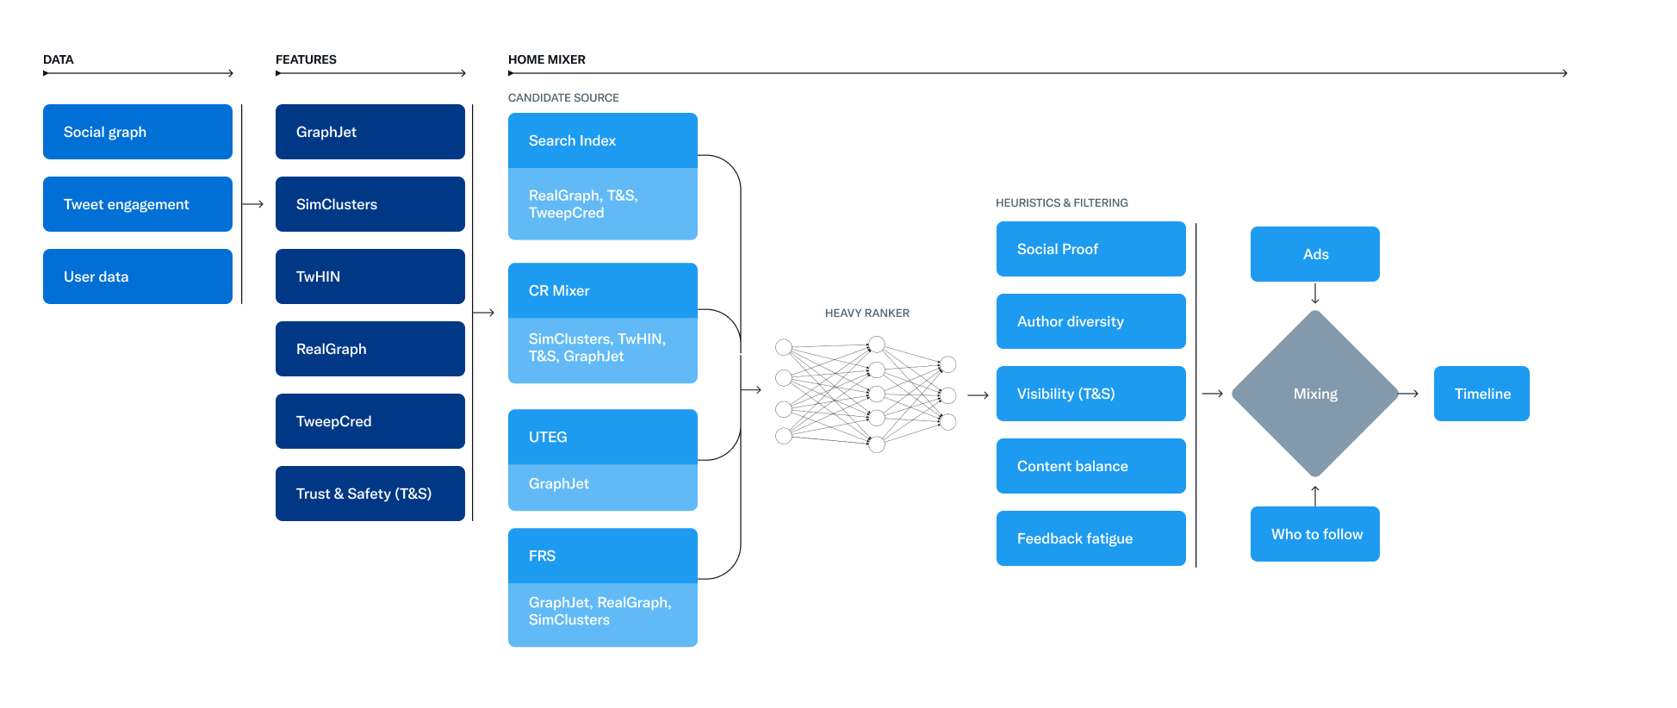
Twitter's Algo Open Source at github
TwHIN is an important feature
Home Mixer / CR Mixer: retrieve in-network (750) and out-of-network tweets (750)
Heavy Ranker: MaskNet multiple objective learning model to rank the tweets

Slide 21
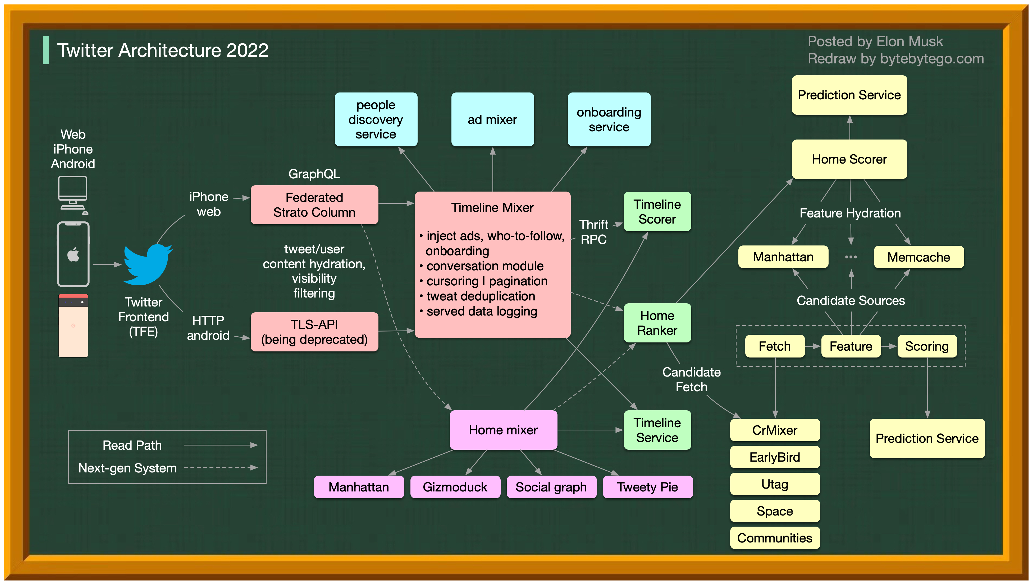
Notes:
https://twitter.com/alexxubyte/status/1594008281340530688

Slide 22

Thank you for your attention!

Slide 23
References
Arxiv Pdf
Twitter's Recommendation Algo Open Source
Twitter Architecture 2022
Open source Blog
Open source machine learning algo
CS224W: Machine Learning with Graphs

Slide 25
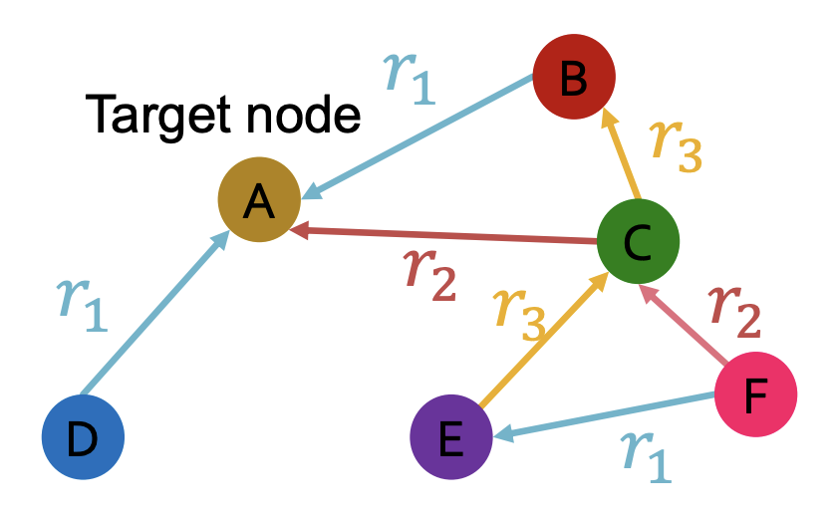
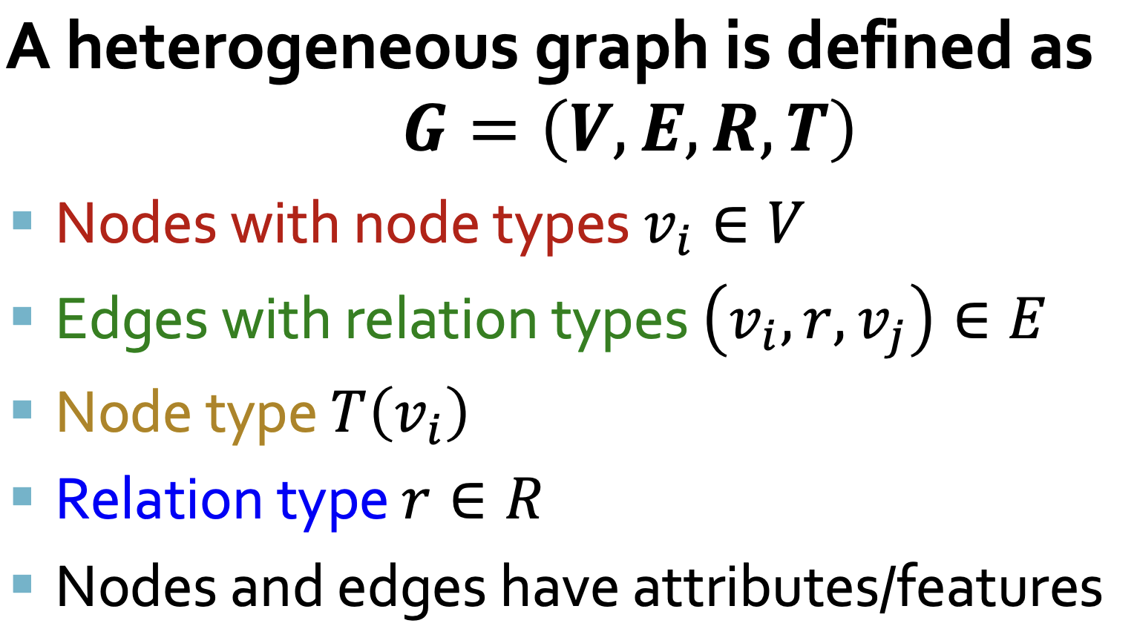
Heterogeneous graph
Heterogeneous graphs: a graph with multiple relation types

Slide 26
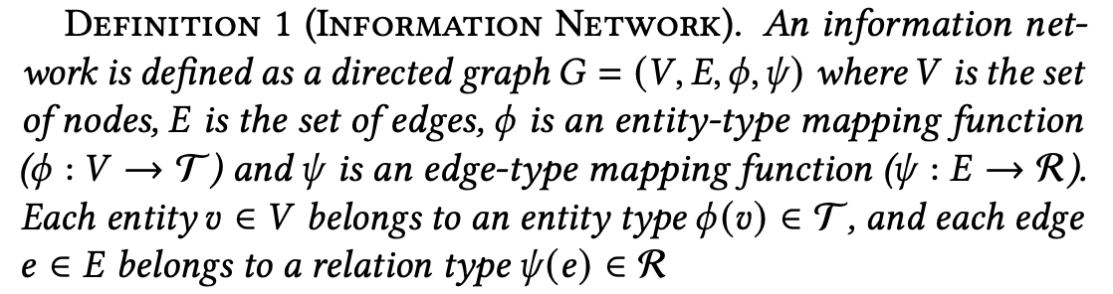
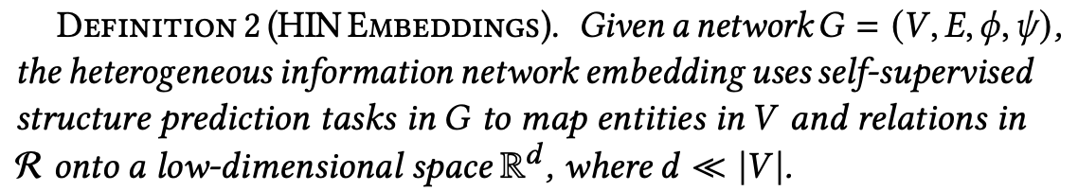
TwHIN embedding definition
dimension 𝑑
embeddings for each entity

